Slide 1
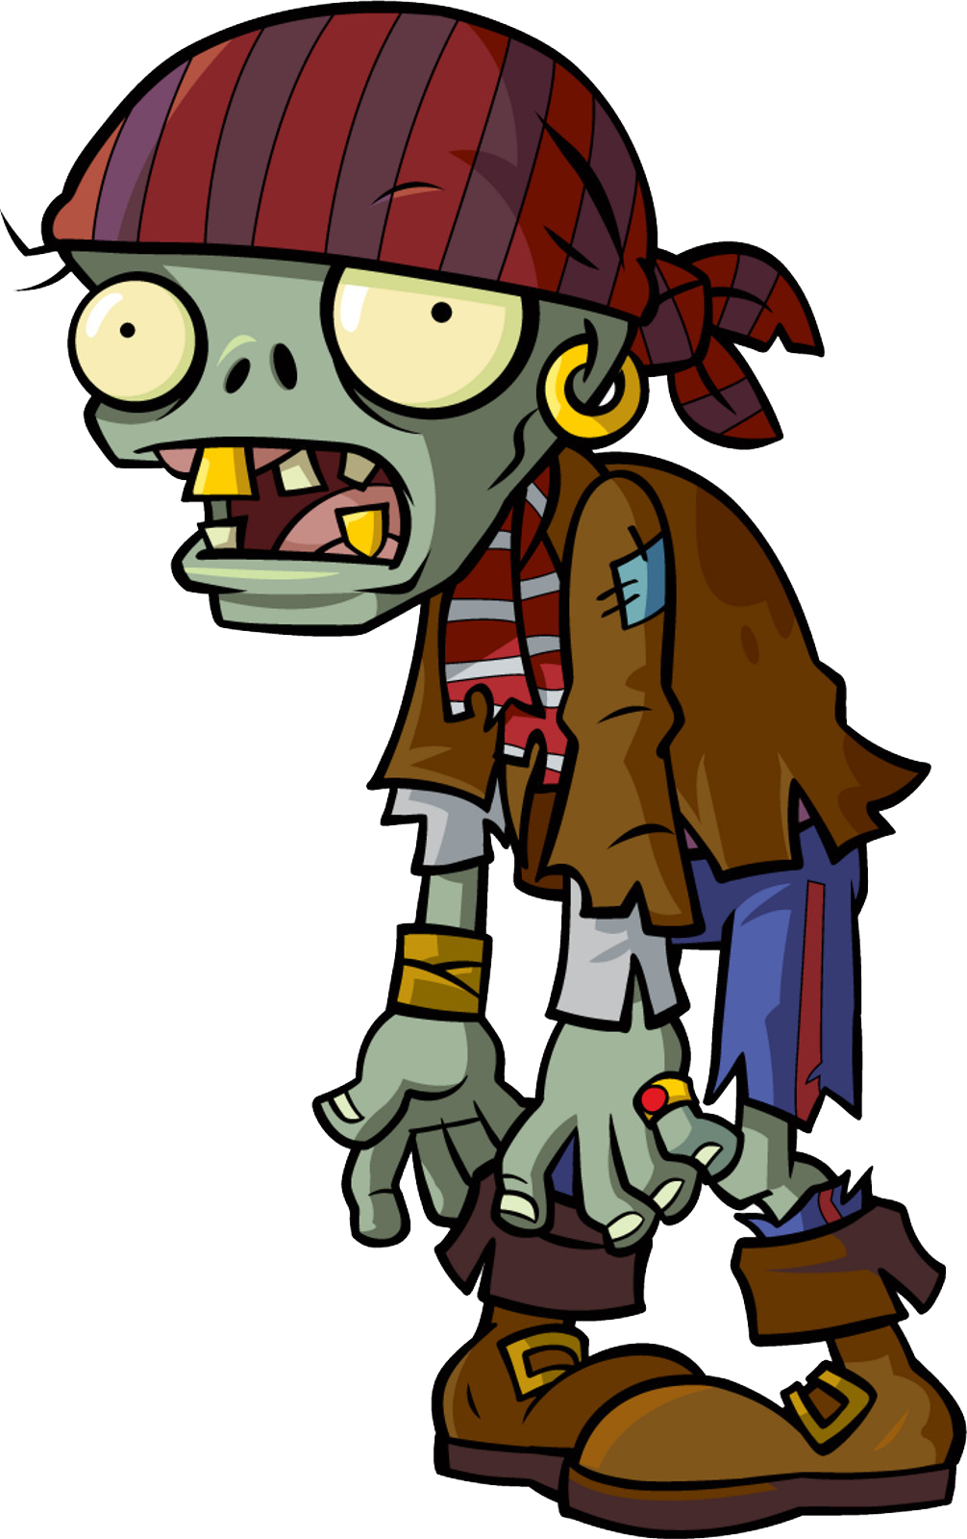
Caravan - Z
Social Gaming Praktikum – Group 30
Munich, 27. July 2022

Slide 2
Index
Game Idea
Basic interactions with the server
Trading
World
Battle

Slide 3
Game Idea
Location based survival game in a post apocalyptic world
Collect resources by moving to real-world places
Battle with zombies that spawn on the world
Turn-based combat
Fight together with your friends
Weather and day/night system
Social aspects
Friends
Guilds
Trading
Fighting together

Slide 4
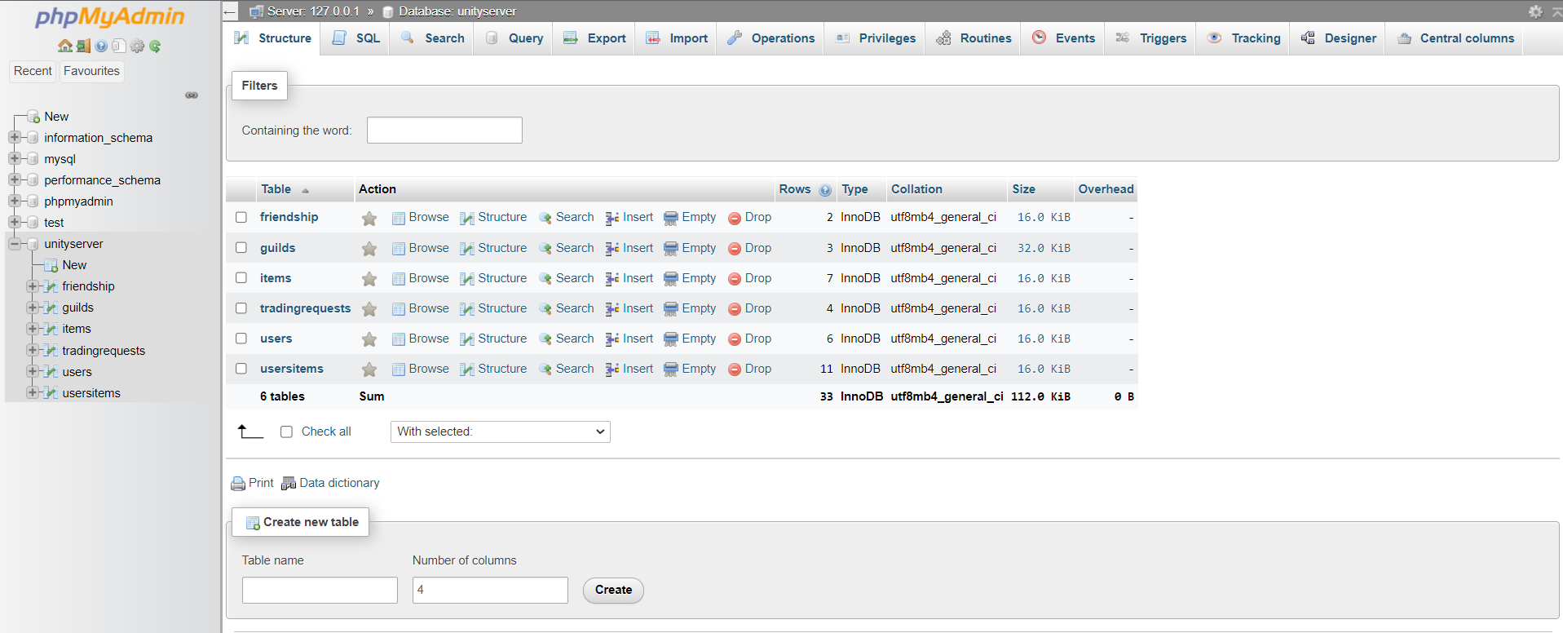
Basic Interactions with the Server
Server – SQL database using XAMPP - php Api

Slide 5
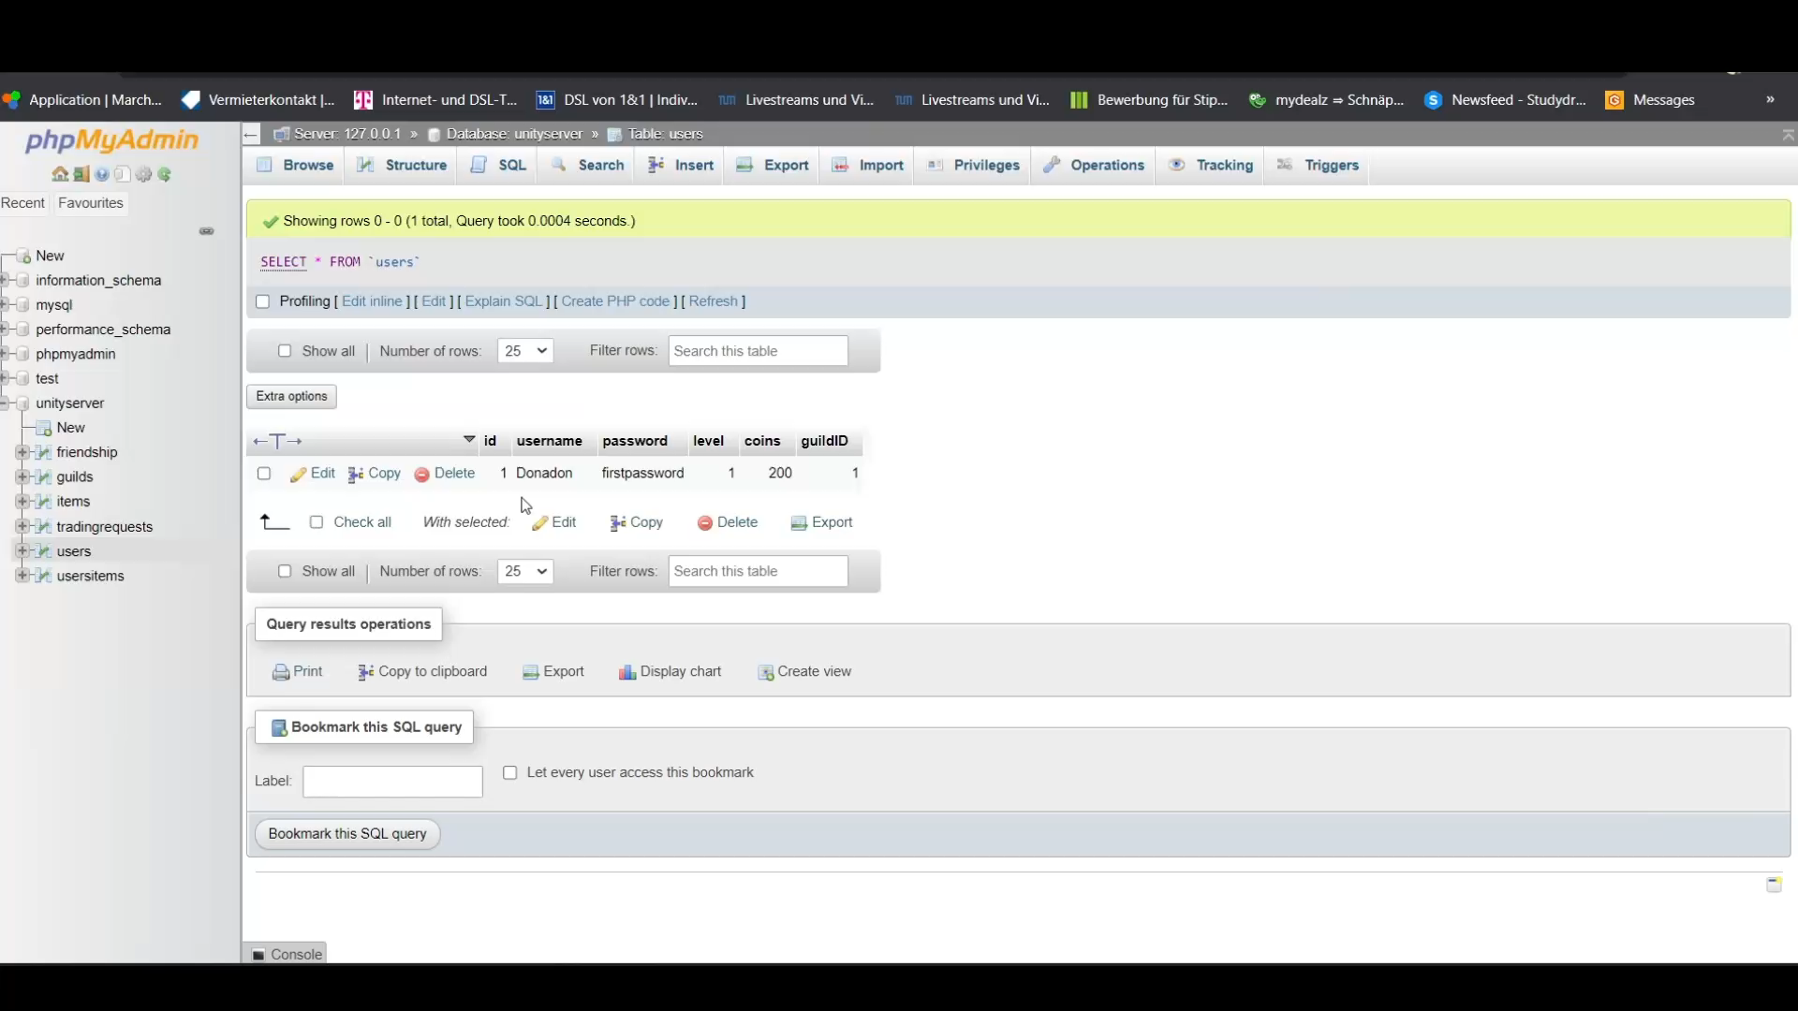
Basic Interactions with the Server
Account management and friends

Slide 6
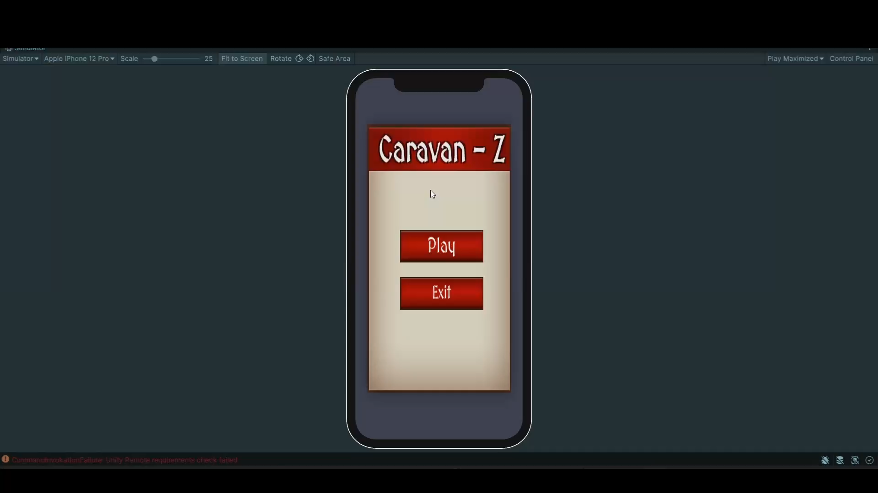
Basic Interactions with the Server
Account management and friends

Slide 7
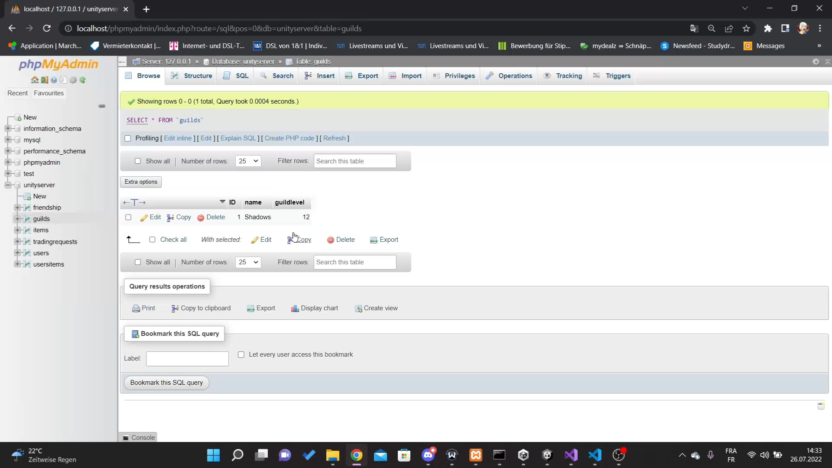
Basic Interactions with the Server
Guild management

Slide 8
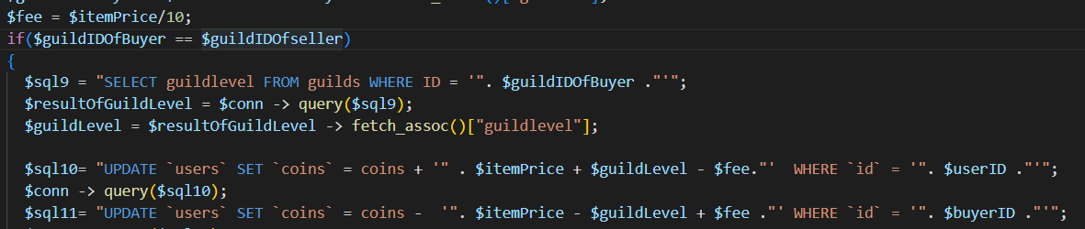
Trading
Trading items for coins
Fee – coins get lost on the transaction
Players in the same guild – smaller fee depending on guild level
Seller
Buyer

Slide 9
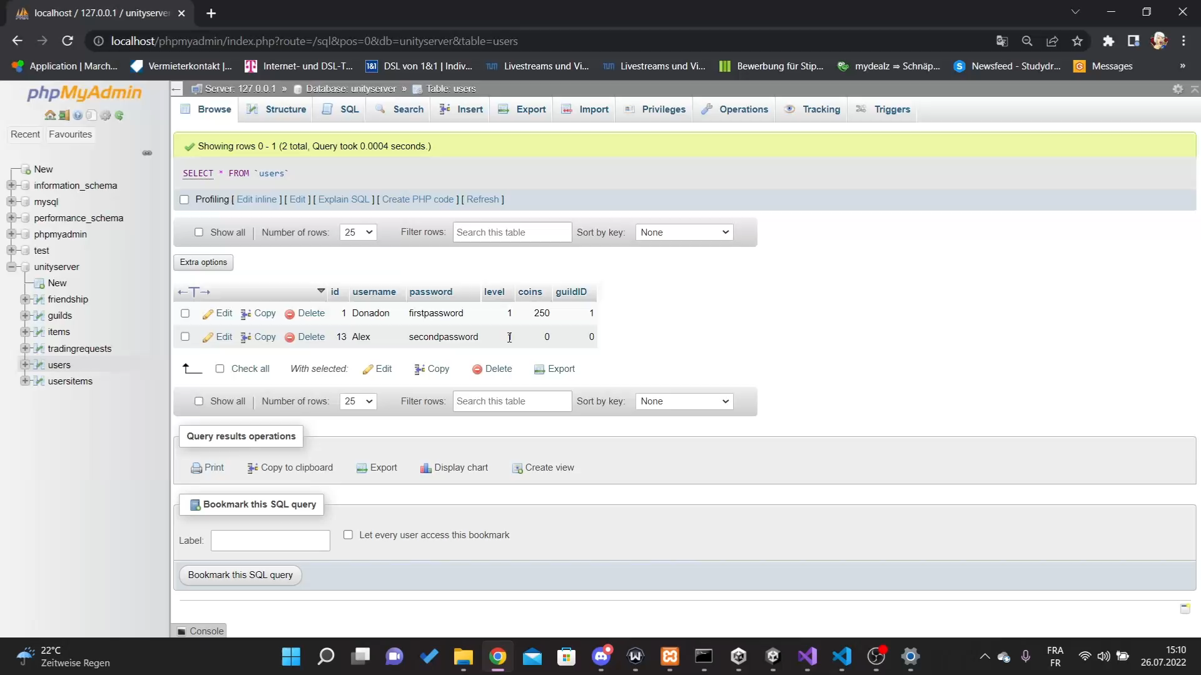
Trading

Slide 10
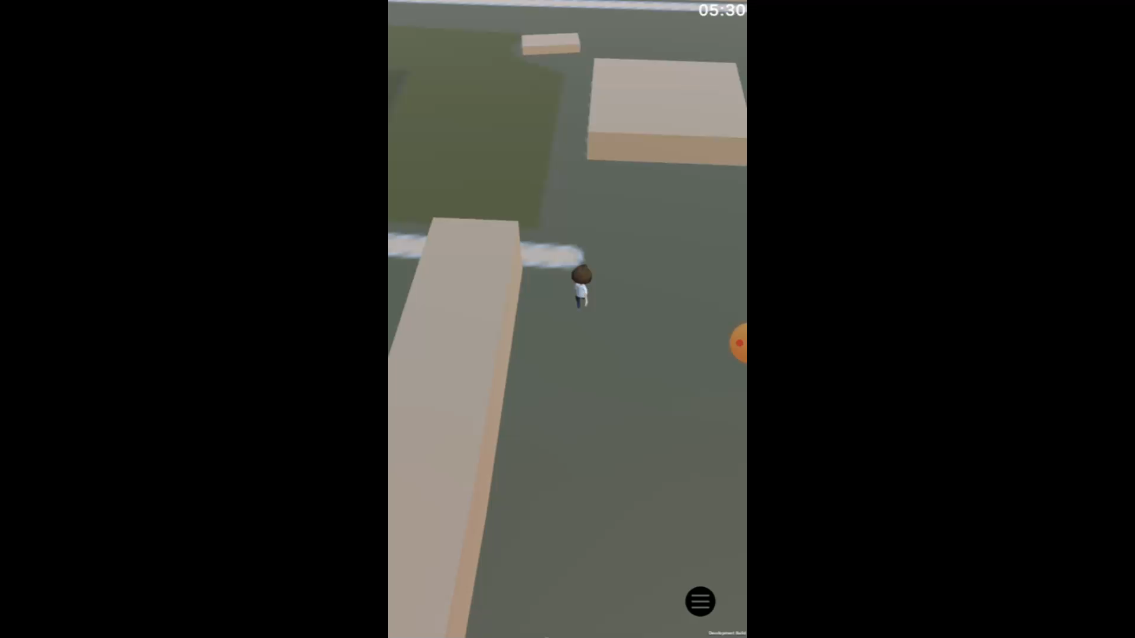
World
Location and map with Mapbox Api
Based on location – Player position, Zombies and markers

Slide 11
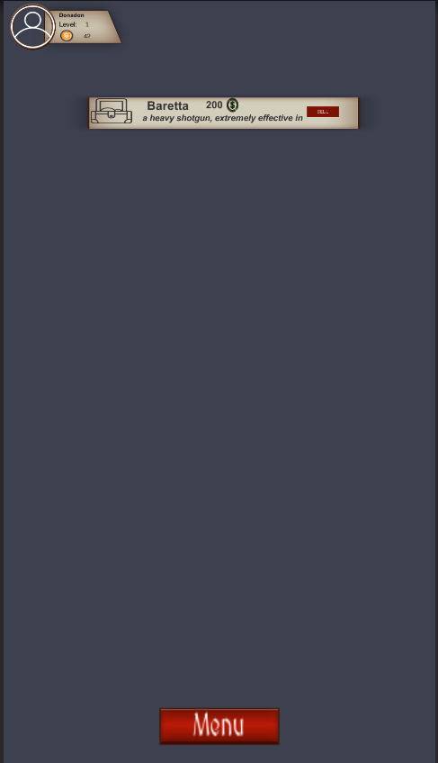
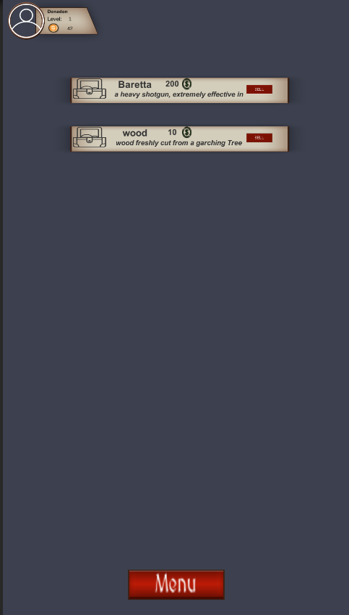
World

Slide 12
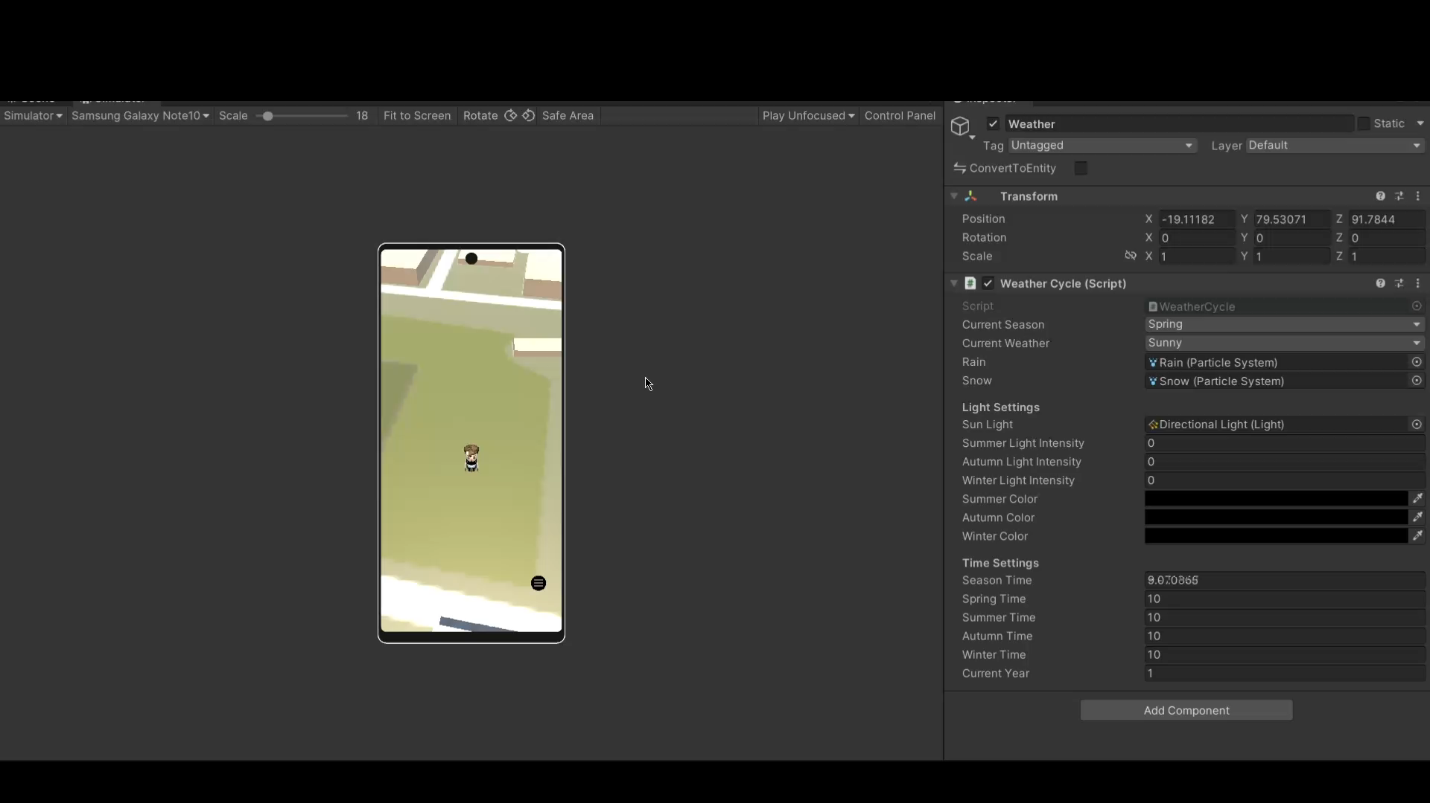
World
Weather and day and night system

Slide 13
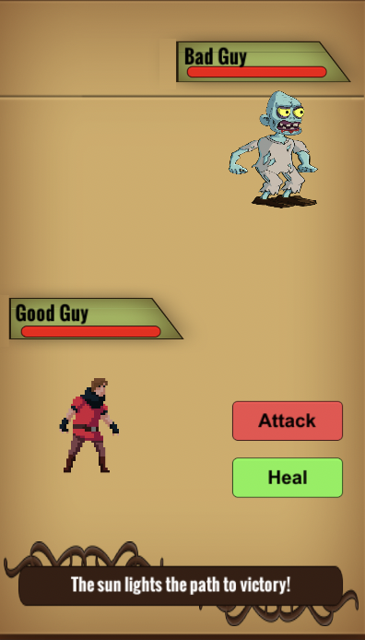
Battle
Turn base battle
Team bonus
Weather
Day and night system

Slide 14
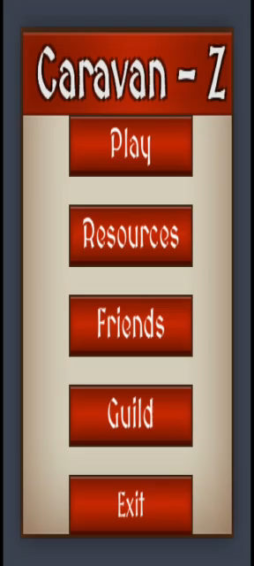
Battle

